Slide 1
Bivariate distributions
-Covariances& correlations
-Correlations & causality
- Independence between RV’s

Slide 2
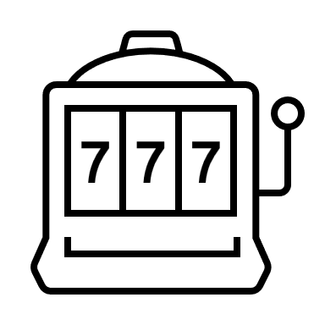
A bivariate distribution
“Bi” means two. A bivariate distribution is the probability distribution of two random variables.
Examples:
A NTU student’s height and weight
A company’s profit and size
A patients’ heart rate and blood pressure
Sample space
RV 1
Hello,
I am an outcome
-2 -1 0 1 2 3 4 5 6 7 8 9 10
-2 -1 0 1 2 3 4 5 6 7 8 9 10
RV 2

Slide 3
Relationship between random variables
As it turns out, RV1 and RV2 are “related” differently
There are RV’s that tend to move in the same direction.
There are RV’s that tend to move in the opposite direction.
There are RV’s that are not related

Slide 4
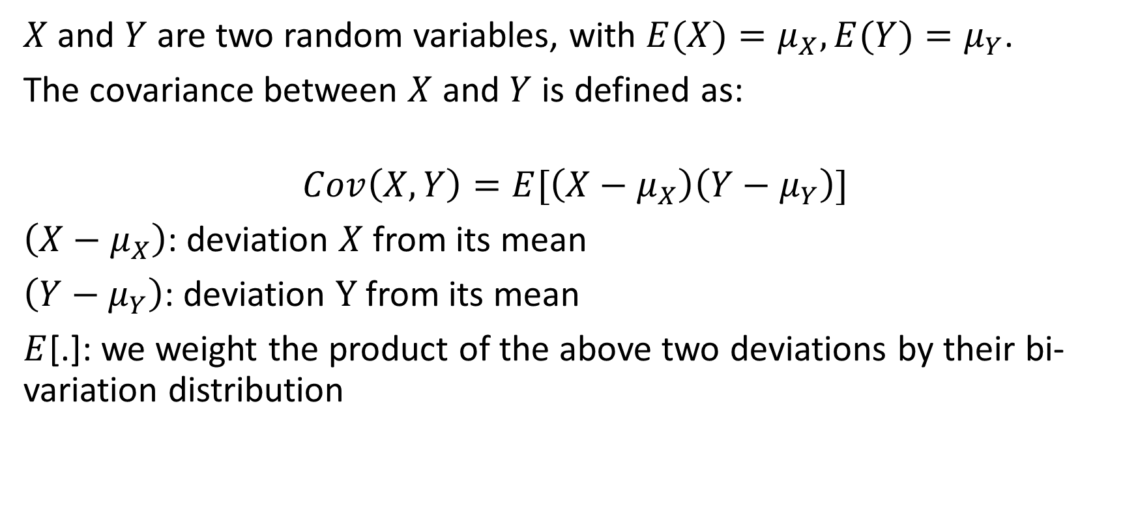
Co-variance of X and Y
$X$ and $Y$ are two random variables, with $E(X)=μ_{X},E(Y)=μ_{Y}$.
The covariance between $X$ and $Y$ is defined as:
$$Cov\left(X,Y\right)=E[\left(X−μ_{X}\right)\left(Y−μ_{Y}\right)]$$
$\left(X−μ_{X}\right)$: deviation $X$from its mean
$\left(Y−μ_{Y}\right)$: deviation $Y$from its mean
$E$[.]: we weight the product of the above two deviations by their bi-variation distribution

Slide 5
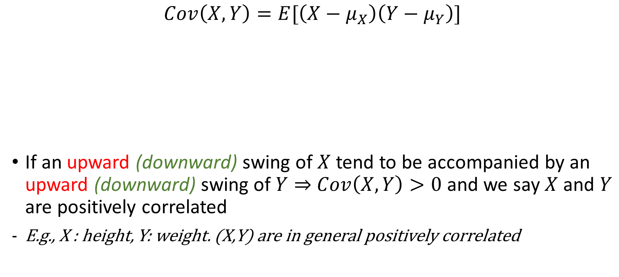
Positive correlation
$$Cov\left(X,Y\right)=E[\left(X−μ_{X}\right)\left(Y−μ_{Y}\right)]$$
If an upward (downward) swing of $X$ tend to be accompanied by an upward (downward) swing of $Y⇒$ $Cov\left(X,Y\right)>0$ and we say $X$ and $Y$ are positively correlated
E.g., X : height, Y: weight. (X,Y) are in general positively correlated

Slide 6

Negative correlation
$$Cov\left(X,Y\right)=E[\left(X−μ_{X}\right)\left(Y−μ_{Y}\right)]$$
If an upward swing of $X$ tend to be accompanied by a downward swing of $Y⇒$ $Cov\left(X,Y\right)<0$ and we say $X$ and $Y$ are negatively correlated
E.g., X : Hr exercises, Y: bodyfat. (X,Y) are in general negatively correlated

Slide 7

No correlation
$$Cov\left(X,Y\right)=E[\left(X−μ_{X}\right)\left(Y−μ_{Y}\right)]$$
If a swing of $X$ is not accompanied by a systematic swing of $Y⇒$ $Cov\left(X,Y\right)=0$ and we say $X$ and $Y$ are uncorrelated
If $\left(X,Y\right)$ are independent, they must also be uncorrelated

Slide 8
No correlation
$$Cov\left(X,Y\right)=E[\left(X−μ_{X}\right)\left(Y−μ_{Y}\right)]$$
If a swing of $X$ is not accompanied by a systematic swing of $Y⇒$ $Cov\left(X,Y\right)=0$ and we say $X$ and $Y$ are uncorrelated
If $\left(X,Y\right)$ are independent, they must also be uncorrelated

Slide 9

Co-variance of X and X
$$Cov\left(X,X\right)=E[\left(X−μ_{X}\right)\left(X−μ_{X}\right)]$$
$$=E\left[{\left(X−μ_{X}\right)}^{2}\right]$$
$$=Var\left(X\right)≥0$$
Variance of $X$ is equal to $Cov\left(X,X\right)$

Slide 10
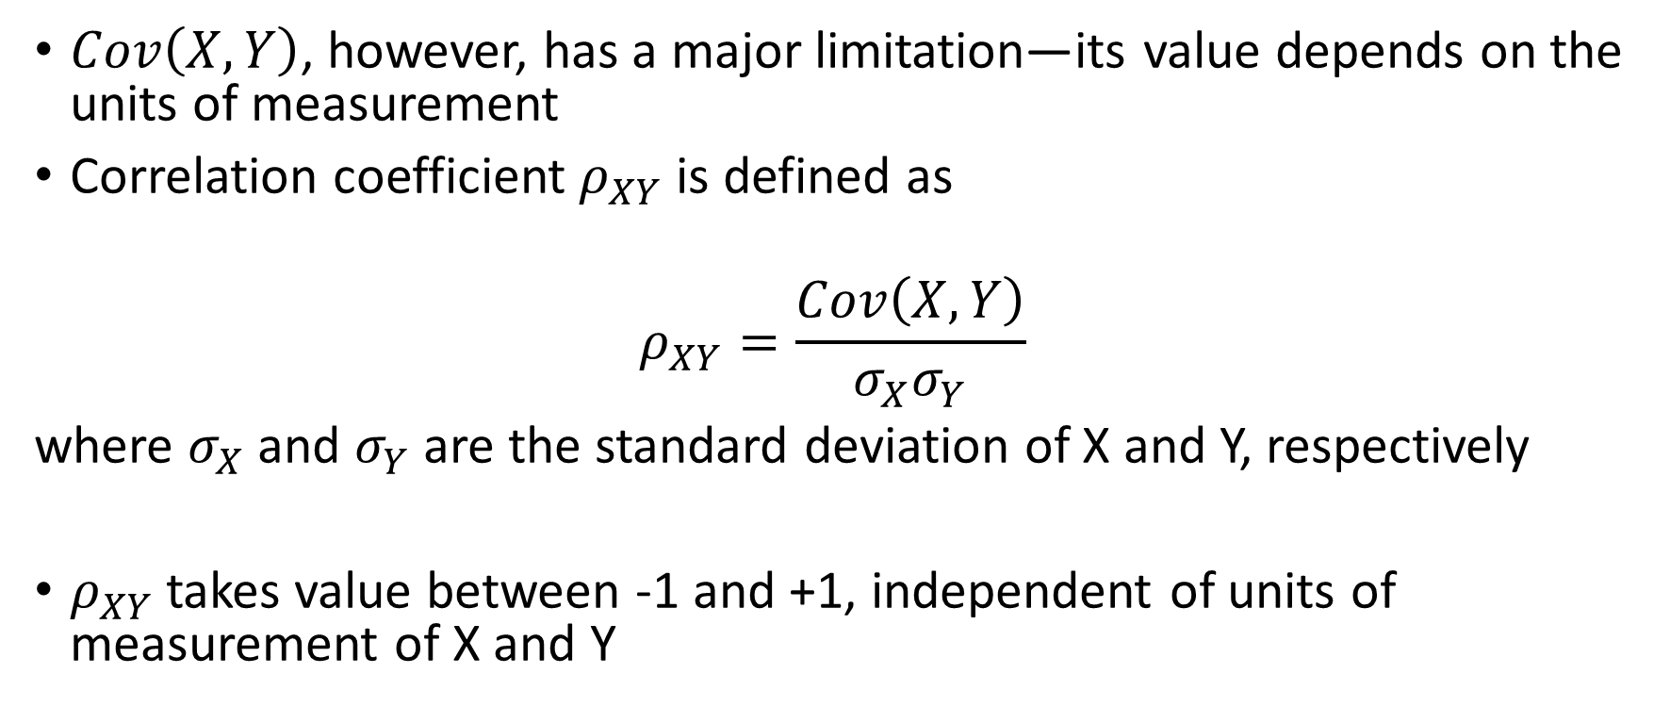
Correlations explained
$Cov\left(X,Y\right)$, however, has a major limitation—its value depends on the units of measurement
Correlation coefficient $ρ_{XY}$ is defined as
$$ρ_{XY}=\frac{Cov\left(X,Y\right)}{σ_{X}σ_{Y}}$$
where $σ_{X}$and $σ_{Y}$ are the standard deviation of X and Y, respectively
$ρ_{XY}$takes value between -1 and +1, independent of units of measurement of X and Y

Slide 11
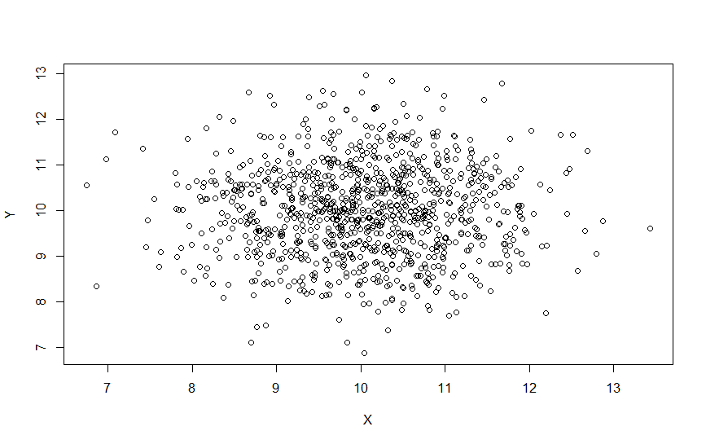
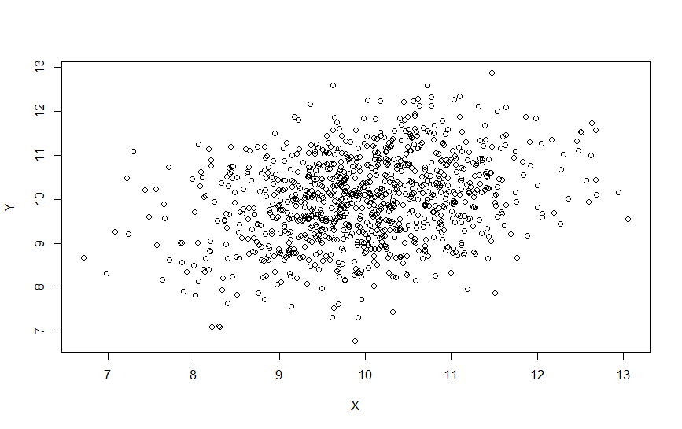
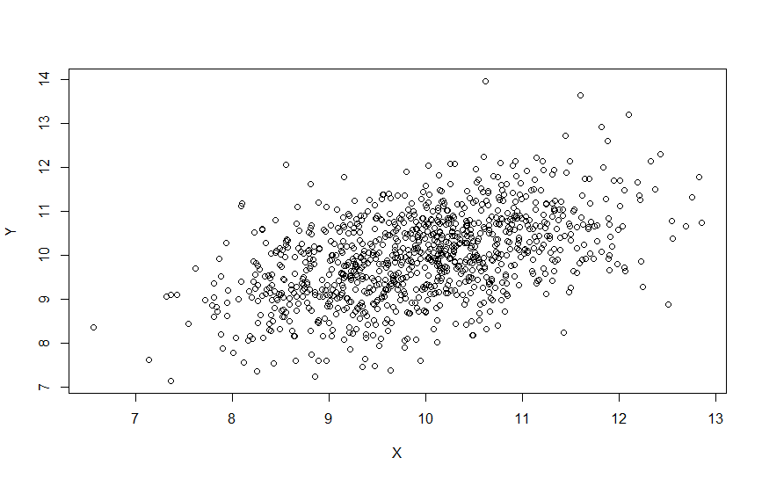
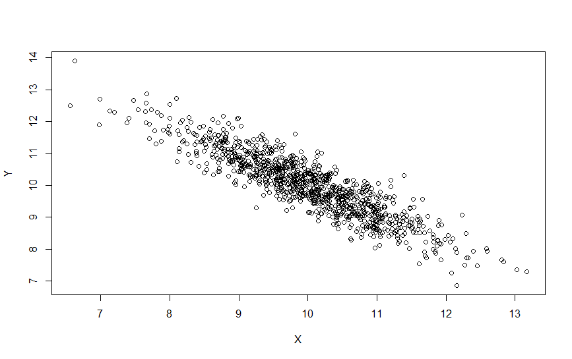
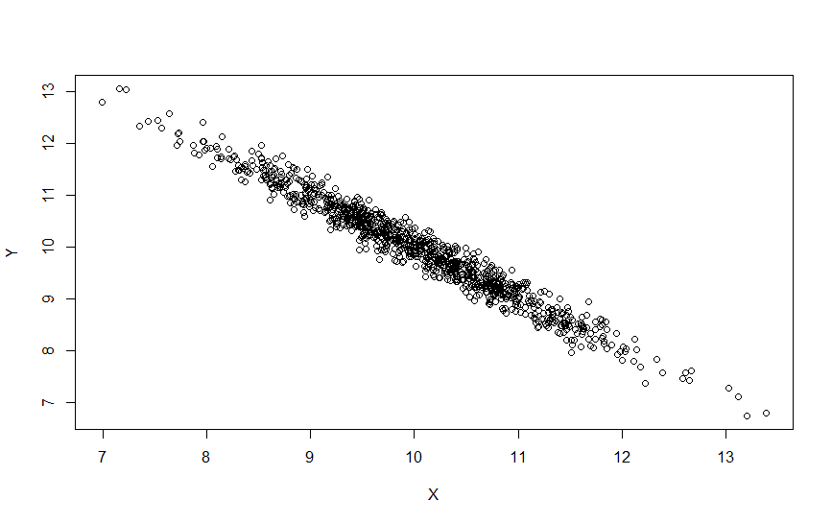
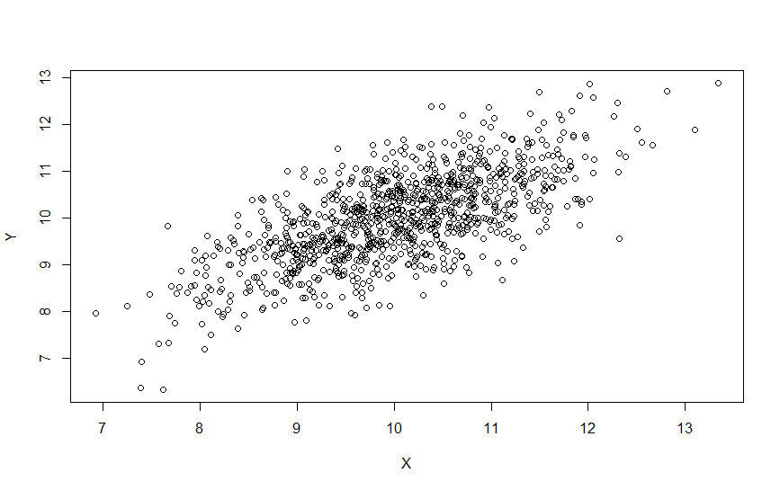






Each figure contains 1,000 computer-generated observations under a different $ρ_{XY}$ value
$$ρ_{XY}=0$$
$$ρ_{XY}=+0.3$$
$ρ_{XY}=+$0.5
$$ρ_{XY}=+0.7$$
$$ρ_{XY}=−0.9$$
$ρ_{XY}=−0.9$8
Observe that the closer ${|ρ}_{XY}|$ is to 1, the more pronounced the linear relationship between X and Y is.

Slide 12

Correlation and variances
Recall these two properties:
We now extend them to the following more general properties
$Property 2:Var\left(aX+c\right)$=$a^{2}Var\left(X\right)$
$Property 3:Var\left(X_{1}+X_{2}\right)=Var\left(X_{1}\right)+Var\left(X_{2}\right)$ if $X_{1}, X_{2}$ are independent
$Var\left(aX_{1}+{bX}_{2}\right)=a^{2}Var\left(X_{1}\right)+b^{2}Var\left(X_{2}\right)+2ab Cov(X_{1},X_{2})$
$⇒Var\left(aX_{1}+{bX}_{2}\right)=a^{2}Var\left(X_{1}\right)+b^{2}Var\left(X_{2}\right)+2ab(ρ_{X_{1}X_{2}}$ $σ_{X_{1}}σ_{X_{2}}$)

